Slide 1
ISO & GeoDCAT-AP Pilot - Working Team T-1B Kick-off meeting
Agreement on a good practice for describing Data Services / APIs (FI & DK & JRC)

Slide 2
Content
The work in a nutshell: An agreement on a Good Practice for describing Data Services / APIs
INSPIRE Good Practice Data Service Linking Simplification: Good Practice guidelines
Its not the only approach! “Classic approach”
DCAT-AP´s main entities and their relationship
Observations related to transformation ISO19139 -> DCAT-AP
4.1 dcat:distribution
4.2 dcat:accessService
4.3 dcat:servesDataset
4.4 gmd:MD_Format
Next steps

Slide 3
The work in a nutshell
Agreement on a Good Practice for describing Data Services / APIs

Slide 4
The work in a nutshell
Background
Issues in present mapping of services. For example, the SEMIC XSLT mapping is based on a metadata element (Function), which is not widely in use in INSPIRE metadata. If the element doesn’t exist, Distributions will not be created by the XSLT and all service information will go missing.
Work
Investigate options to do the mapping in other manners
Check that mapping rules and resulting DCAT-files support HVD-reporting
Outcome
Make a Good Practice document and/or propose suggestions for update of Data Service Linking Simplification: Good Practice guidelines
XML examples of ISO metadata

Slide 5
INSPIRE Good Practice Data Service Linking Simplification: Good Practice guidelines

Slide 6
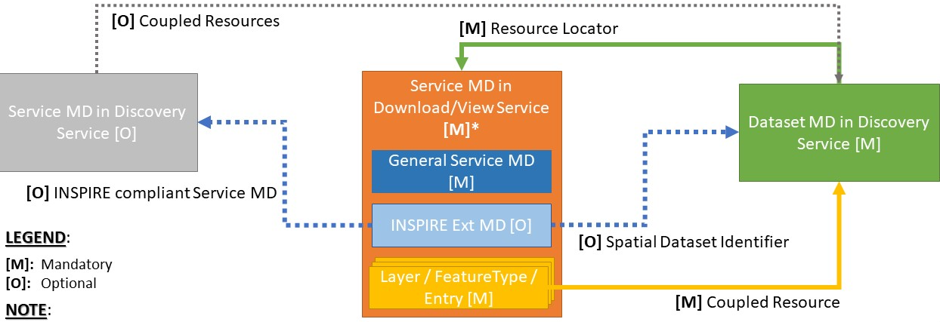
INSPIRE Data Service Linking Simplification: Good Practice guidelines
https://github.com/INSPIRE-MIF/gp-data-service-linking-simplification/blob/main/good-practice/data-service-linking-simplification-spec.md

Slide 7
Requirement: INSPIRE Download Service linkage
Requirement | /req/download-linkage
A | A Resource Locator to an INSPIRE Download Service providing download access to the described data set or data set series SHALL be given. It SHALL be encoded using the /gmd:MD_Metadata/gmd:distributionInfo/gmd:MD_Distribution/gmd:transferOptions/gmd:MD_DigitalTransferOptions/gmd:onLine/gmd:CI_OnlineResource element.
B | The element gmd:URL SHALL point to the response of the Get Download Service Metadata request of the Download Service
C | The element gmd:protocol SHALL be present.
D | If the element gmd:protocol is encoded using gmx:Anchor, the attribute gmx:Anchor/@xlink:href SHALL point to the URI of one of the values in https://inspire.ec.europa.eu/metadata-codelist/ProtocolValue.
E | If the element gmd:protocol is encoded using gco:CharacterString, the text value of gco:CharacterString SHALL match the label of one of the values in https://inspire.ec.europa.eu/metadata-codelist/ProtocolValue in the language of the metadata language.
F | The element gmd:applicationProfile SHALL be present.
G | If the element gmd:applicationProfile is encoded using gmx:Anchor, the attribute gmx:Anchor/@xlink:href SHALL point to https://inspire.ec.europa.eu/metadata-codelist/SpatialDataServiceType/download.
H | If the element gmd:applicationProfile is encoded using gco:CharacterString, the text value of gco:CharacterString SHALL match the label of https://inspire.ec.europa.eu/metadata-codelist/SpatialDataServiceType/download in the language of the metadata language.

Slide 8
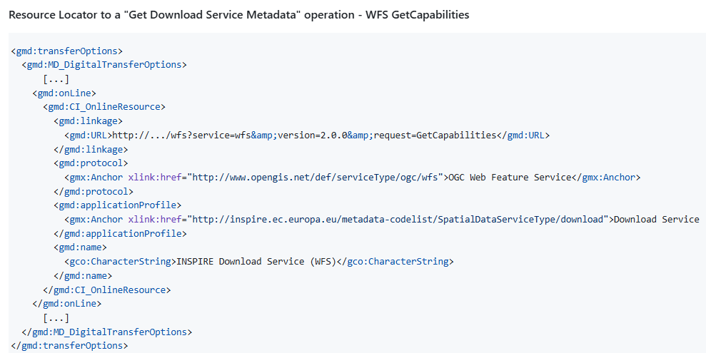
Example
Enough for mapping to DCAT-AP…? Nope…

Slide 9
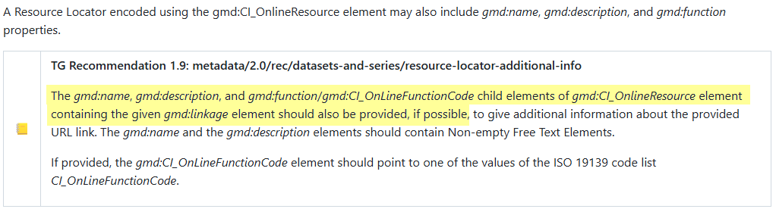
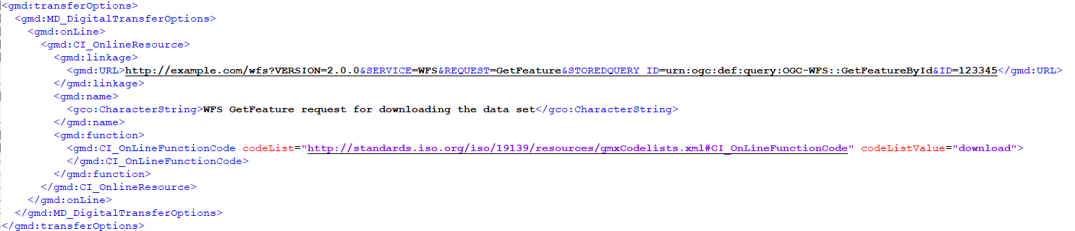
gmd:CI_OnLineFunctionCode is essential!
Technical Guidance for the implementation of INSPIRE dataset and service metadata based on ISO/TS 19139:2007
https://github.com/INSPIRE-MIF/technical-guidelines/blob/main/metadata/metadata-iso19139/metadata-iso19139.adoc#resource-locator-for-data-set-or-series

Slide 10
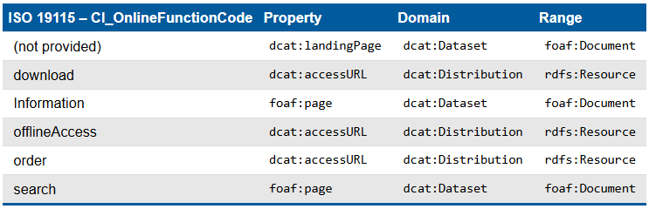
ISO OnlineFunctionCode -> DCAT-AP
A.7.4 Resource locator - *On-line resource · Issue #139 · SEMICeu/GeoDCAT-AP

Slide 11
DCAT-AP´s main entities and their relationship

Slide 12
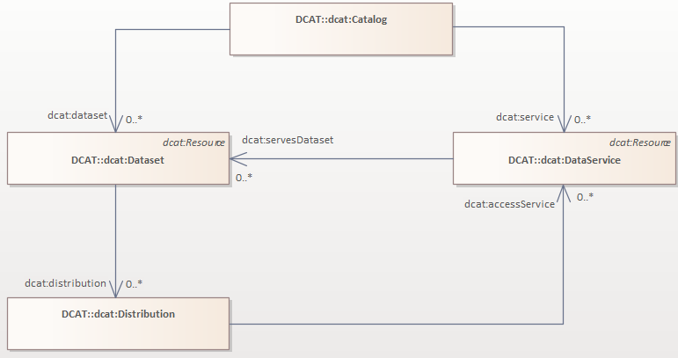

Slide 13
Observations related to transformation ISO19139 -> DCAT-AP

Slide 14
4 How to map from ISO19139 to DCAT-AP regarding
4.1 dcat:distribution
4.2 dcat:accessService
4.3 dcat:servesDataset
4.4 gmd:MD_Format

Slide 15
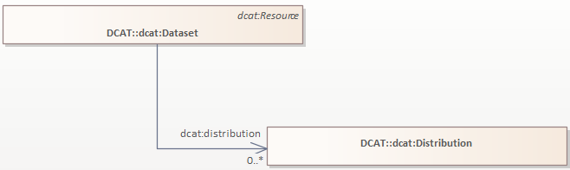
4.1 dcat:distribution
dcat:distribution: Connects a dataset to its available distributions.
dcat:Distribution: A physical embodiment of the Dataset in a particular format.
Mapping:
ISO19139´s gmd:MD_Distribution -> DCAT-APs dcat:Distribution

Slide 16
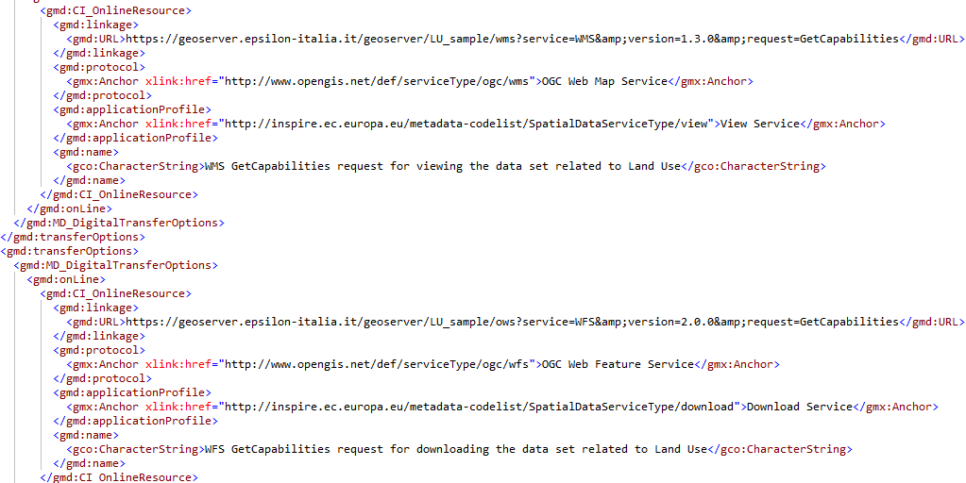
ISO19139:gmd:MD_Distribution -> DCAT::dcat:Distribution
OGC WMS
OGC WFS

Slide 17
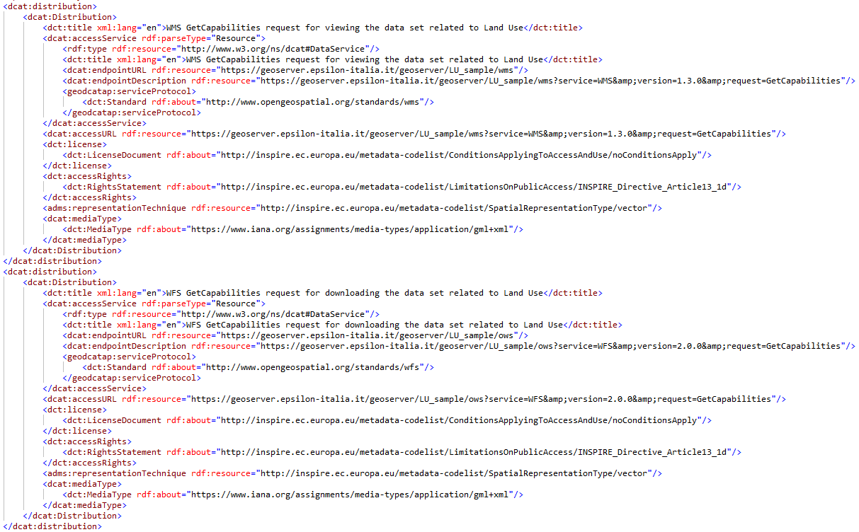
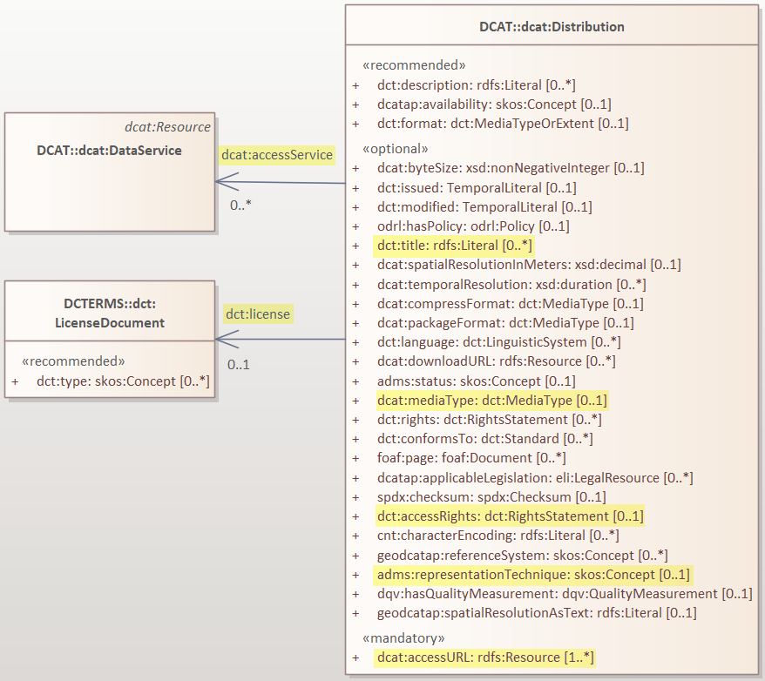
ISO19139:gmd:MD_Distribution -> DCAT::dcat:Distribution
OGC WMS
OGC WFS

Slide 18
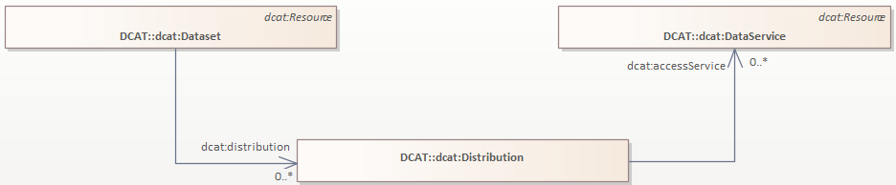
4.2 dcat:accessService
dcat:accessService: A site or end-point that gives access to the distribution of the dataset.
Via the dataset’s distribution (from the Dataset via the [distribution] attribute to the Distribution instance and then from the Distribution instance via the [accessService] attribute to the Service

Slide 19
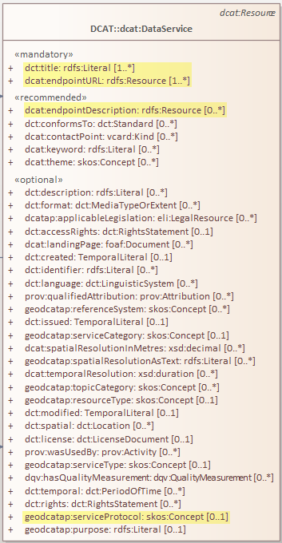
4.2 dcat:accessService
Case 1

Slide 20
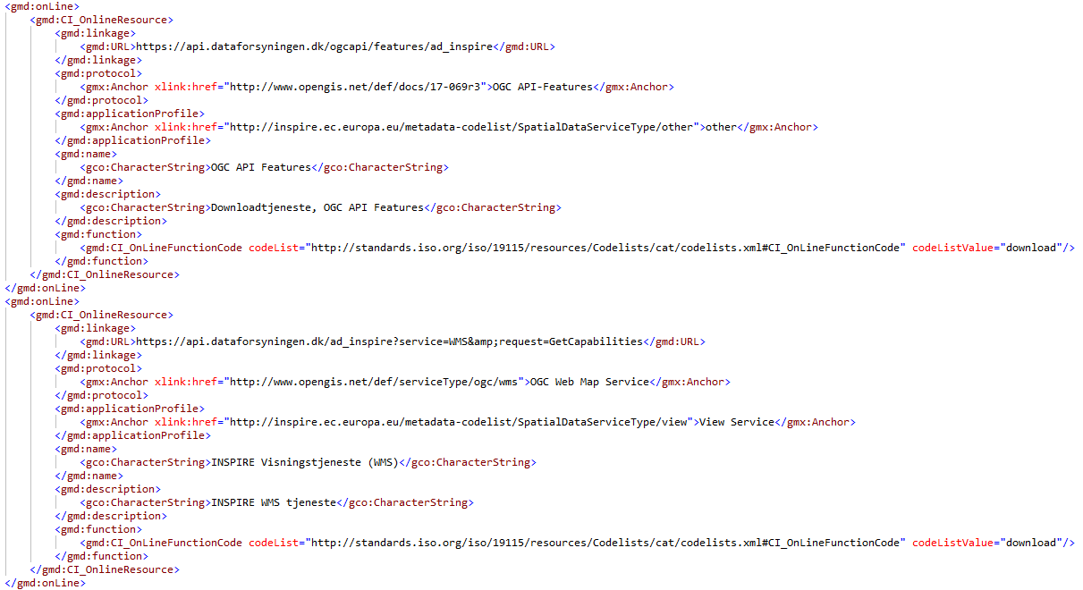
4.2 dcat:accessService
Case2
OGC API Features
OGC WMS

Slide 21
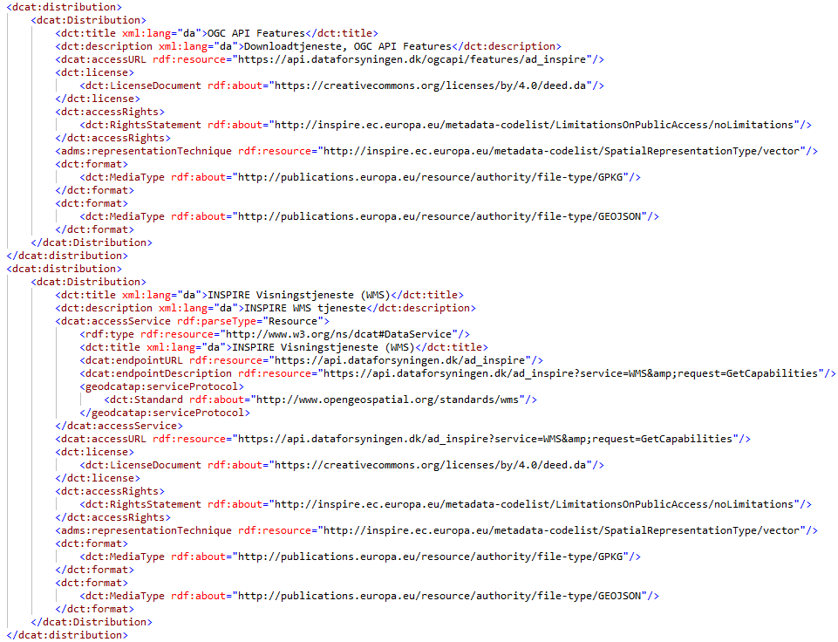
4.2 dcat:accessService
Case2
OGC API Features
No dcat:accessService!
OGC WMS

Slide 22
4.2 dcat:accessService Need for update iso-19139-to-dcat-ap.xsl
Topic for discussion
XSLT has a template called detect-service, which checks if the URL contains "getCapabilities”
Only …/gmd:MD_Distribution/gmd:transferOptions/…/gmd:onLine/…/gmd:linkage/gmd:URL containing ”getCapabilities” is mapped to dcat:accessService
Which seems to be too strict?
OGC API Features does not have a getCapabilities document.
See https://github.com/SEMICeu/iso-19139-to-dcat-ap/issues/98

Slide 23
4.3 dcat:servesDataset
dcat:servesDataset: A collection of data that this DataService can distribute.
dcat:DataService: A collection of operations that provides access to one or more datasets or data processing functions.
Mapping:
ISO19139´s Service Metadata srv.operatesOn -> DCAT-APs dcat:servesDataset

Slide 24


4.3 dcat:servesDataset Need for update iso-19139-to-dcat-ap.xsl
Topic for discussion
If ISO19139:Metadata Service in srv:operatesOn refers to a Metadata Dataset by xlink:href
No dcat:servesDataset is generated by iso-19139-to-dcat-ap.xsl
If ISO19139:Metadata Service in srv:operatesOn refers to a Metadata Dataset by uuidref and xlink:href
No dcat:servesDataset is generated by iso-19139-to-dcat-ap.xsl
If ISO19139:Metadata Service in srv:operatesOn refers to a Metadata Dataset only by uuidref
A dcat:servesDataset is generated by iso-19139-to-dcat-ap.xsl:

Slide 25
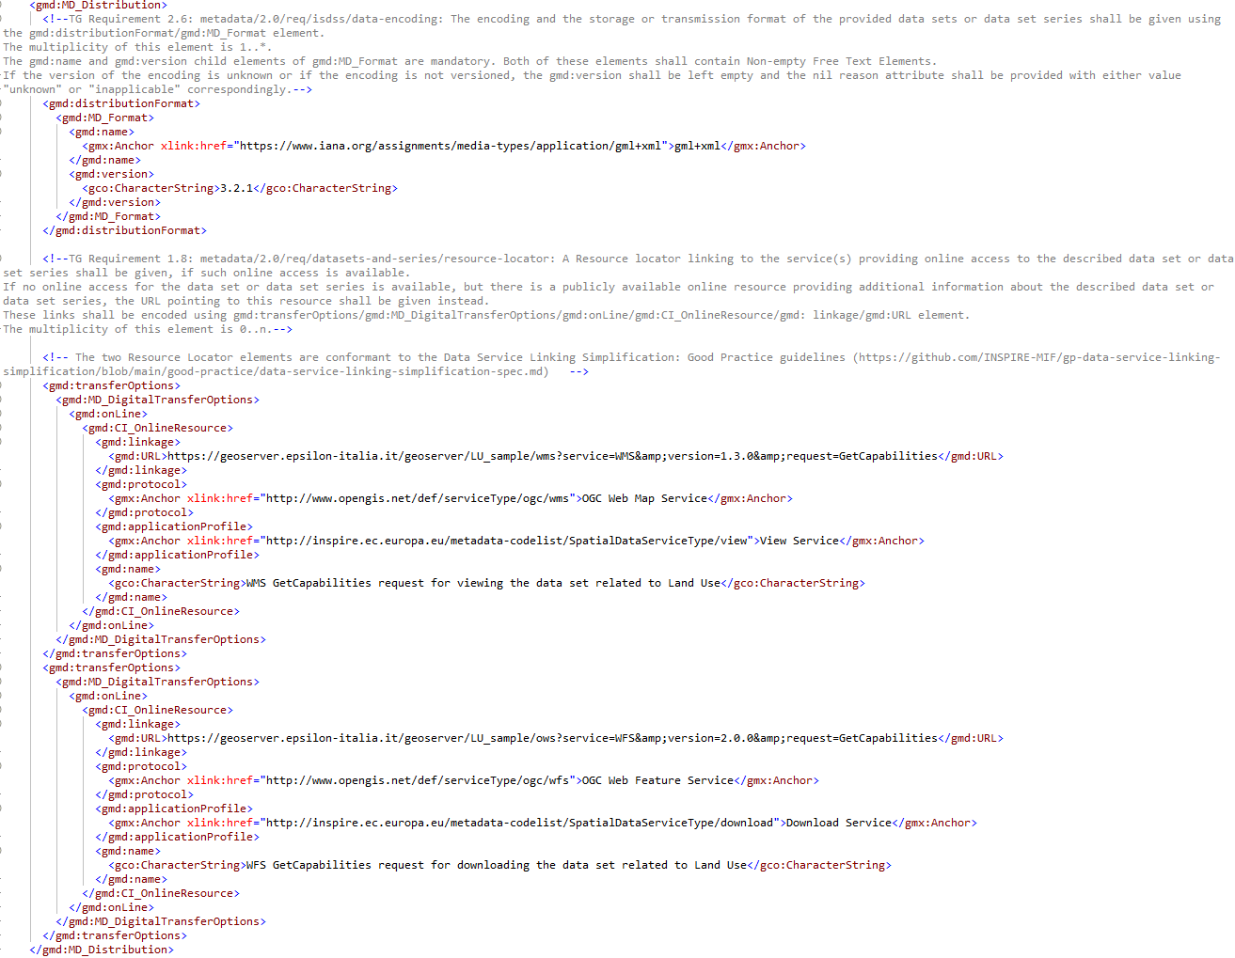
4.4 Mapping of gmd:MD_Format ISO19139:gmd:MD_Distribution -> DCAT::dcat:Distribution
Case 1
gml+xml

Slide 26
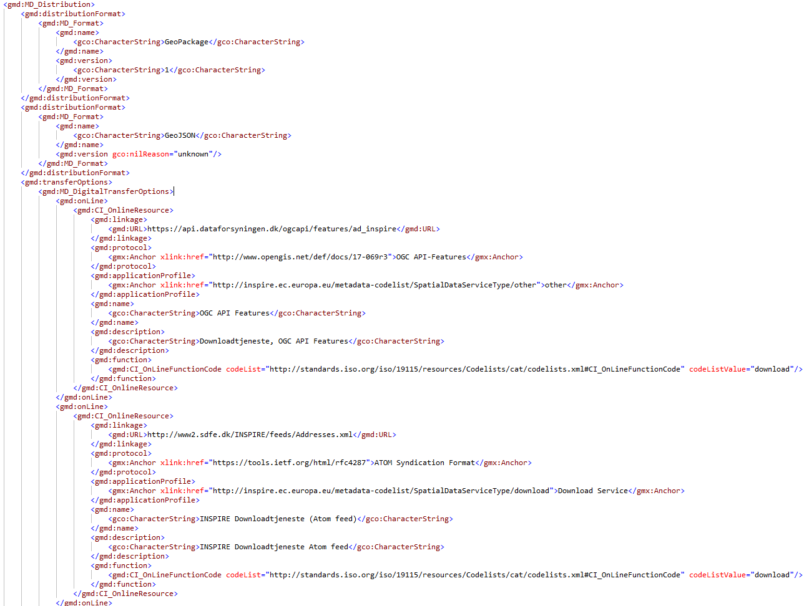
4.4 Mapping of gmd:MD_Format ISO19139:gmd:MD_Distribution -> DCAT::dcat:Distribution
GeoPackage
GeoJSON

Slide 27
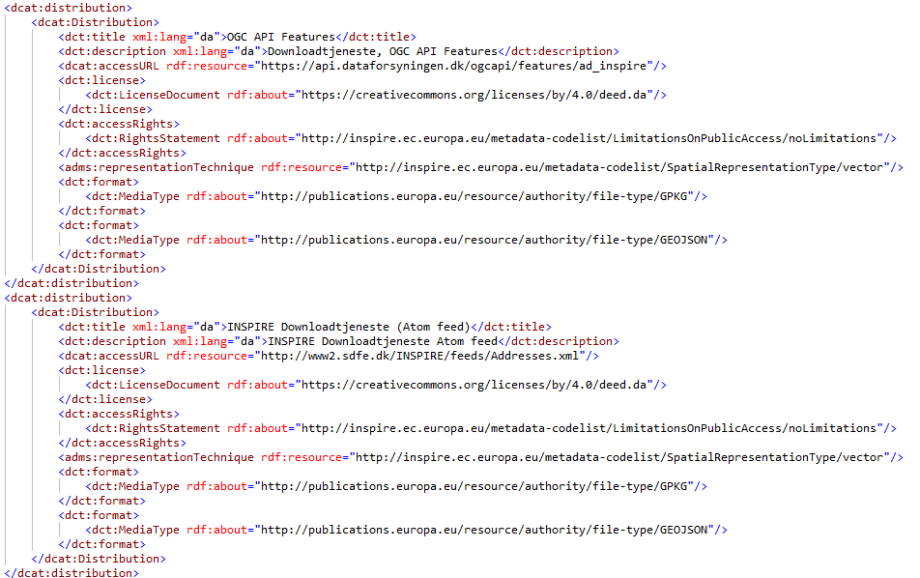
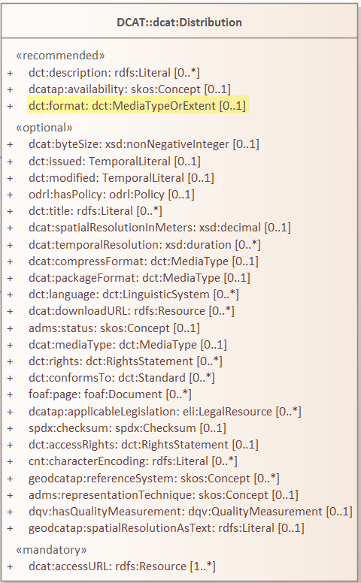
4.4 Mapping of gmd:MD_Format ISO19139:gmd:MD_Distribution -> DCAT::dcat:Distribution
OGC API
Features
Atom feed
Mapped to dct:format because
/gmd:MD_Metadata/…/…/…/
gmd:MD_Format/gmd:name/gmx:Anchor
does not points to IANA
See https://github.com/INSPIRE-MIF/GeoDCAT-AP-pilot/issues/8

Slide 28
Next steps

Slide 29
Next steps
How to work together?
Monthly meetings
Separate work meetings or agreement on who works on what?
GitHub repository for draft documents and discussions?
Before next meeting in March/April
Further investigation of possible options
A.7.4 Resource locator - *On-line resource · Issue #139 · SEMICeu/GeoDCAT-AP
Interaction with standardisation bodies
Comments on the overall goal and focus?

